Slide 1
Alternatives to (Student) t-Tools
Rank Sum Test
Welch’s Test
Sign Test / Signed Rank Test

Slide 2
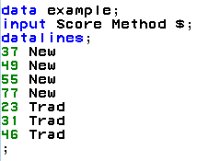
Let’s Start With an Example
IBM gives each employee in the marketing department technical training
Based on further testing, it appears the traditional training method isn’t effective
Hence, a new training method is developed
Below are the test scores of 4 individuals who just finished the “New Method” and the last 3 test scores from employees trained via the “Traditional Method” course
Is there evidence to suggest that the “New Method” increases test scores?
New Method | Traditional Method
37 | 23
49 | 31
55 | 46
77

Slide 3
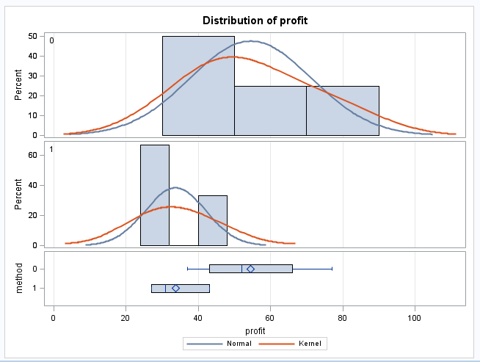
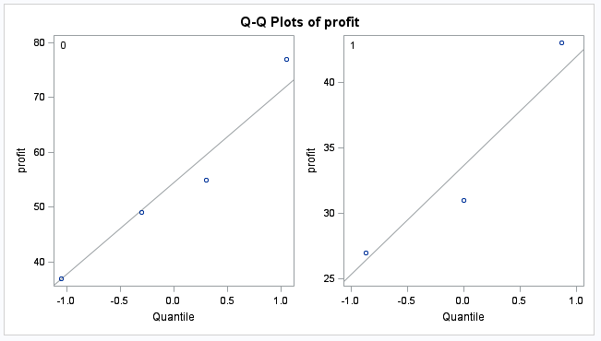
Examining the t-Tools Assumptions
2
2
1
1
Since the standard deviations appear (visual check) to be different and the sample sizes are both different and exceptionally small, the t-test was not deemed appropriate and the nonparametric rank sum test was performed.

Slide 4
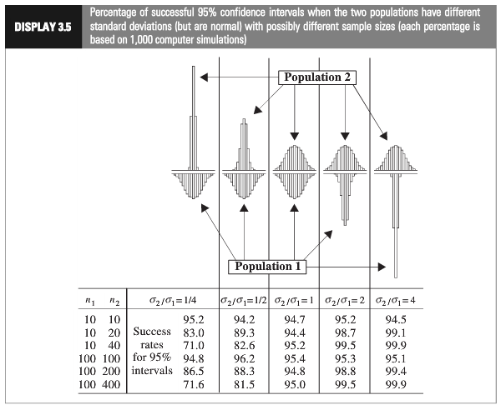
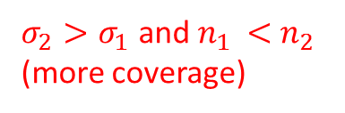
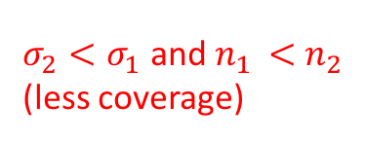
2
1
Which situation does it appear we are in?
$σ_{2}<σ_{1}$ and $n_{1 }<$ $n_{2 }$
(less coverage)
$σ_{2}>σ_{1}$ and $n_{1 }<$ $n_{2 }$
(more coverage)
Using a t-test could have low power.
Notes:
Worst case: the variance from the larger group is smaller than the variance from smaller group:

Slide 5
Nonparametric Methods: The Rank Sum Test

Slide 6
Nonparametric Methods
A nonparametric or distribution-free test doesn’t depend on underlying assumptions
This makes them ideal for use when the assumptions of non-nonparametric (that is, parametric) tests aren’t met
The trade-off is that nonparametric methods perform somewhat worse than parametric methods if the assumptions are approximately correct
The first nonparametric method we will consider is the ”rank sum test”

Slide 7
Rank Sum Test: Advantages
No distributional assumptions
Resistant to outliers
Performs nearly as well as the t-test when the two populations are normal and considerably better when there are extreme outliers
Works well with ordinal (as opposed to interval data)
Works with censored values
It still requires some assumptions:
All observations are independent
The Y values are ordinal
59 patients with arthritis who participated in a clinical trial were assigned to two groups, active and placebo. The response status:
(excellent=5, good=4, moderate=3, fair=2, poor=1)
of each patient was recorded.

Slide 8
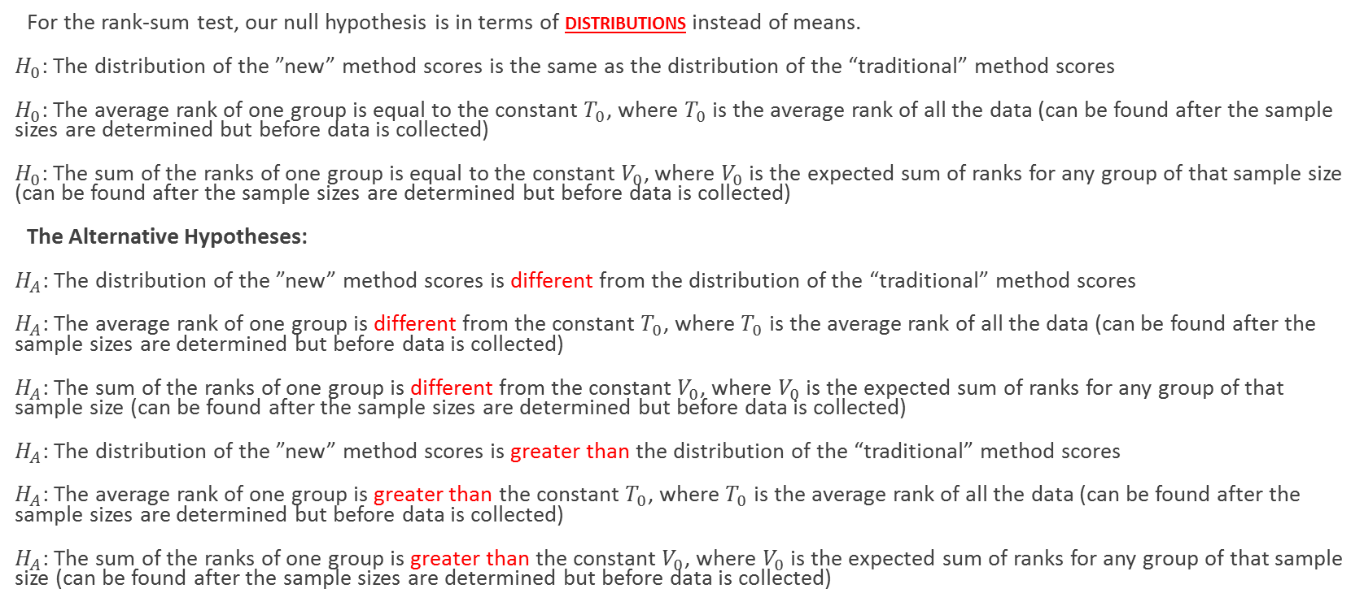
The Hypothesis Test
For the rank-sum test, our null hypothesis is in terms of distributions instead of means.
$H_{0}$: The distribution of the ”new” method scores is the same as the distribution of the “traditional” method scores
$H_{0}$: The average rank of one group is equal to the constant $T_{0}$, where $T_{0}$ is the average rank of all the data (can be found after the sample sizes are determined but before data is collected)
$H_{0}$: The sum of the ranks of one group is equal to the constant $V_{0}$, where $V_{0}$ is the expected sum of ranks for any group of that sample size (can be found after the sample sizes are determined but before data is collected)
The Alternative Hypotheses:
$H_{A}$: The distribution of the ”new” method scores is different from the distribution of the “traditional” method scores
$H_{A}$: The average rank of one group is different from the constant $T_{0}$, where $T_{0}$ is the average rank of all the data (can be found after the sample sizes are determined but before data is collected)
$H_{A}$: The sum of the ranks of one group is different from the constant $V_{0}$, where $V_{0}$ is the expected sum of ranks for any group of that sample size (can be found after the sample sizes are determined but before data is collected)
$H_{A}$: The distribution of the ”new” method scores is greater than the distribution of the “traditional” method scores
$H_{A}$: The average rank of one group is greater than the constant $T_{0}$, where $T_{0}$ is the average rank of all the data (can be found after the sample sizes are determined but before data is collected)
$H_{A}$: The sum of the ranks of one group is greater than the constant $V_{0}$, where $V_{0}$ is the expected sum of ranks for any group of that sample size (can be found after the sample sizes are determined but before data is collected)
(Two sided)
(one sided)

Slide 9
The Rank Sum test
We can compute the rank sum test statistic using the following steps:
List all observations from both groups in increasing order
Assign each observation a rank, from 1 to n
If there are any ties, assign each tied observation’s rank to be the average of their ranks.
Identify each observation by its group
The test statistic, T, is the sum of the ranks in one of the groups.
We can find a p-value in two ways:
Normal approximation
Re-randomization
Note: n is the total # of observations

Slide 10
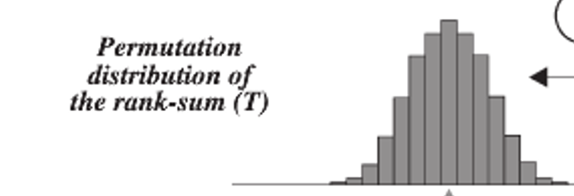
The Sampling Distribution of …
The Rank Sum Statistic!
Rank Sum test statistic (sum of ranks of one group) is approximately normally distributed!

Slide 11
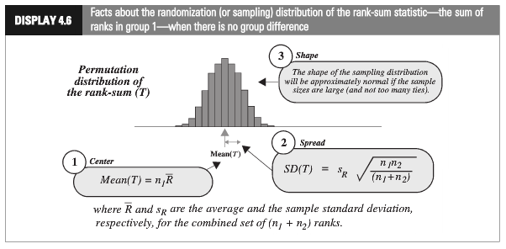
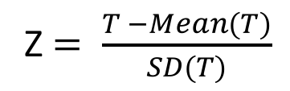
Rank-Sum Test: Normal Approximation
Z $= \frac{T −Mean(T)}{SD(T)}$

Slide 12
Rank Sum Test: randomly assign ranks
Observation # | Group | Rank
1 | New | 5
2 | New | 7
3 | New | 2
4 | New | 1
5 | Trad | 3
6 | Trad | 4
7 | Trad | 6
Observation # | Group | Rank
1 | New | 7
2 | New | 5
3 | New | 2
4 | New | 1
5 | Trad | 3
6 | Trad | 4
7 | Trad | 6
Observation # | Group | Rank
1 | New | 3
2 | New | 4
3 | New | 7
4 | New | 6
5 | Trad | 2
6 | Trad | 5
7 | Trad | 1
Record sum of ranks of one group for all 7! permutations of ranks. (7!=7*6*5*4*3*2*1)
P-value is the number of permutations with a sum equal to or more extreme than the one in the original data set divided by the total number of permutations.

Slide 13
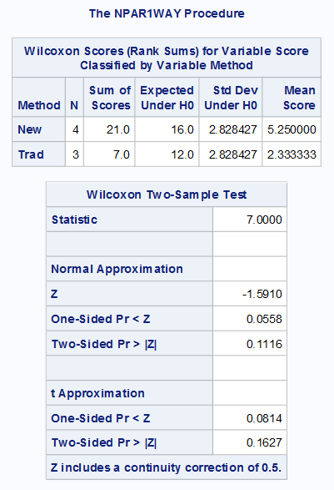

Rank-Sum Test: Normal Approximation
Common interpretation:
H₀: The distribution of New Method Scores = The distribution of the Traditional Method Scores
H₁:The distribution of New Method Scores > The distribution of the Traditional Method Scores
Technical mathematical interpretation:
H₀: Average rank of New Method Scores = Average rank of all Scores (constant)
H₁: Average rank of New Method Scores > Average rank of all Scores (constant)
There is mild evidence (alpha = .1) to suggest that the distribution of scores from the “New” method is greater than the distribution of the “Traditional” method (normal approximation to rank-sum test p-value = 0.0558).

Slide 14
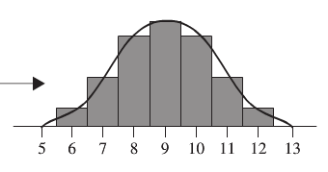
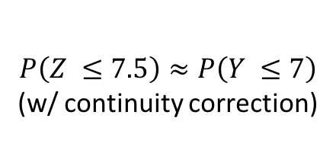
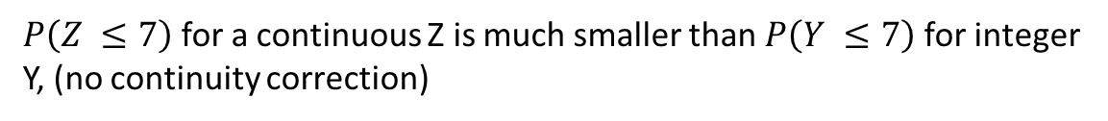
Continuity Correction: Main Idea
$P\left(Z ≤7\right)$ for a continuous Z is much smaller than $P\left(Y ≤7\right)$ for integer Y, (no continuity correction)
$$P\left(Z ≤7.5\right)≈P\left(Y ≤7\right)$$
(w/ continuity correction)
The exact probability calculation for $P(Y ≤7)$ when Y is an integer.

Slide 15
Rank-Sum Test: Normal Approximation
Common interpretation:
H₀: The distribution of New Method Scores = The distribution of the Traditional Method Scores
H₁:The distribution of New Method Scores > The distribution of the Traditional Method Scores
There is mild evidence (alpha = .1) to suggest that the distribution of scores from the “New” method is greater than the distribution of the “Traditional” method (normal approximation to rank-sum test p-value = 0.0558).

Slide 16
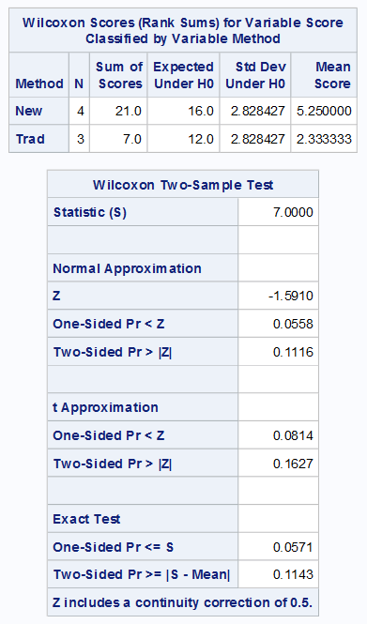

Permutation Test (Exact P-value)
Normal approximation p-values
Exact p-values

Slide 17
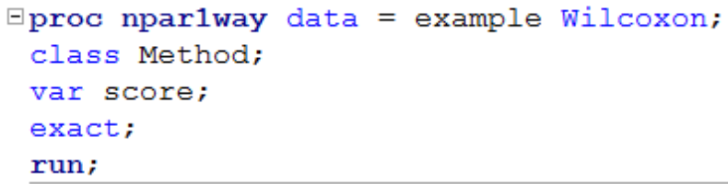
Rank Sum Test (Wilcoxon)
H₀: The distribution of New Method Scores = The distribution of the Traditional Method Scores
H₁:The distribution of New Method Scores > The distribution of the Traditional Method Scores
Critical Value: 1.645
There is sufficient evidence at the alpha = 0.1 level of significance (p-value = .0571 for the exact test) to suggest that the distribution of scores from four IBM employees that were sampled is greater than the distribution of the 3 employees that took the test having had the Traditional Method of instruction.

Slide 18
Rank Sum Test: Advantages
No distributional assumptions
Resistant to outliers
Performs nearly as well as the t-test when the two populations are normal and considerably better when there are extreme outliers
Works well with ordinal (as opposed to interval data)
Works with censored values

Slide 19
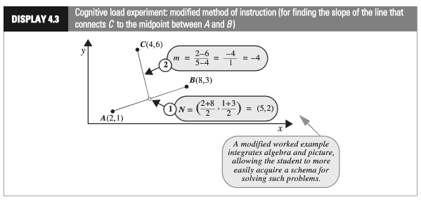
Cognitive Load Experiment
Researchers compared the effectiveness of conventional textbook examples to modified ones
They selected 28 ninth-year students who had no previous exposure to coordinate geometry
The students were randomly assigned to one of two self study instructional groups, using conventional and modified instructional materials
After instruction, they were given a test and the time to complete one of the problems was recorded.
Is there sufficient evidence to suggest that the cognitive load theory (modified instruction) shortened response times?

Slide 20
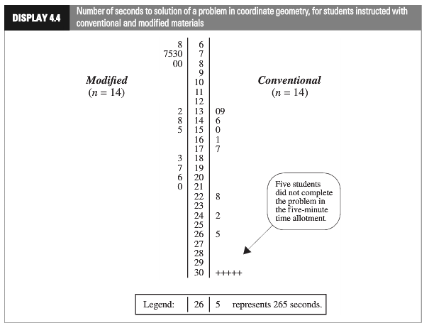
Cognitive Load Experiment
(censored data)

Slide 21
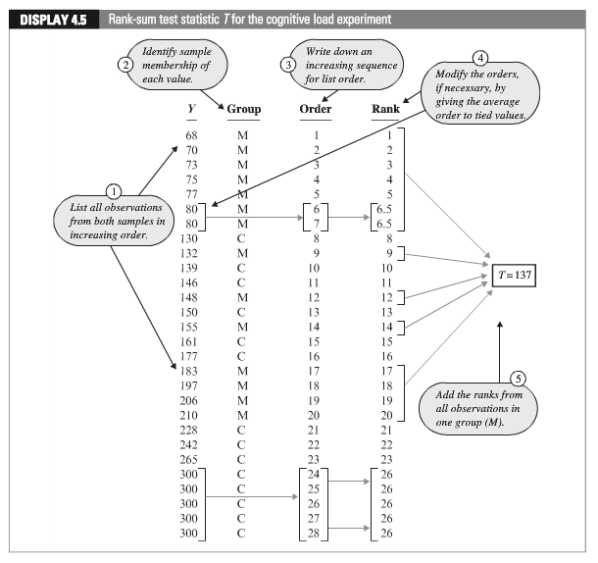
Cognitive Load Experiment
With ties, the ranks are averaged.

Slide 22
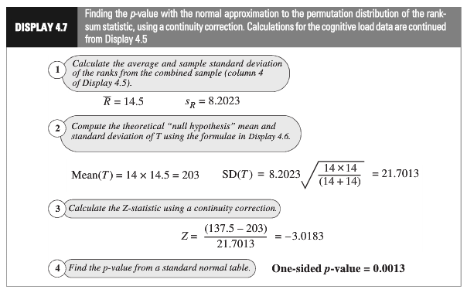
Cognitive Load Experiment: Normal Approximation
(continuity correction)
Statistical Conclusion: The data provide convincing evidence that a student could solve the problem more quickly after the “modiﬁed” rather than the the “conventional” method (one-sided, normal approximation w/ C.C. p-value = 0.0013, from the rank-sum test).

Slide 23
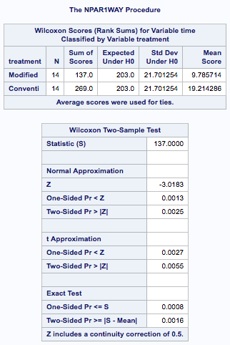
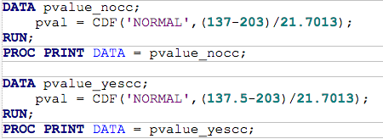



Cognitive Load Experiment: Using SAS

Slide 24
Confidence Interval for the Location Parameter (Median): Hodges Lehman Confidence Interval
https://en.wikipedia.org/wiki/Hodges%E2%80%93Lehmann_estimator
*We will look at an example later

Slide 25

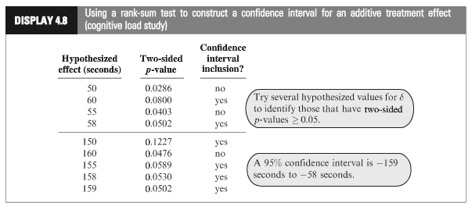
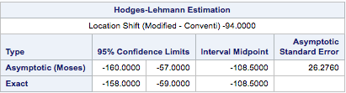
Cognitive Load Experiment
Statistical Conclusion (continued): A range of plausible values for how much smaller the “modified” distribution is than the “traditional” (treatment effect) is [-158, -59] s. (95% conﬁdence interval based on a rank-sum test) with a point-estimate of 108.5 s.

Slide 26
Cognitive Load Experiment (All Together)
Ho: Distribution of Modified and Conventional Scores are equal
Ha: Distribution of Modified Scores is less than that of Conventional
Critical Value (left sided): -1.645 (alpha = .05)
Test Statistic: t-stat = -3.0183
P-value (left sided)= .0013
Reject Ho
Statistical Conclusion (continued): The data provide convincing evidence that a student could solve the problem more quickly after the “modiﬁed” rather than the “conventional” method (one-sided, normal approximation w/ C.C. p-value = 0.0013, from the rank-sum test). A range of plausible values for how much smaller the “modified” distribution is than the “traditional” (treatment effect) is [-158, -59] sec. (95% conﬁdence interval based on a rank-sum test) with a point-estimate of 108.5 sec.

Slide 27
Welch’s t-Test

Slide 28
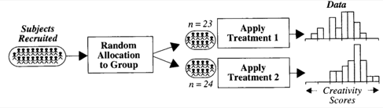

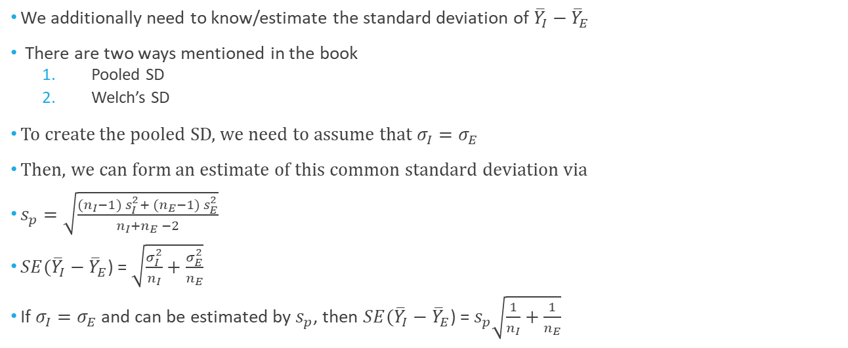

Creativity Study: Reminder
$→$ Population mean: $μ_{I}$
I
$→$ Population sd: $σ_{I}$
$→$ Population mean: $μ_{E}$
E
$→$ Population sd: $σ_{E}$
We additionally need to know/estimate the standard deviation of ${\overline{Y}}_{I}−{\overline{Y}}_{E}$
There are two ways mentioned in the book
Pooled SD
Welch’s SD
To create the pooled SD, we need to assume that $σ_{I}=σ_{E}$
Then, we can form an estimate of this common standard deviation via
$s_{p}=\sqrt{\frac{({n_{I}−1) s}_{I}^{2}+ ({n_{E}−1) s}_{E}^{2}}{n_{I}+n_{E} −2}}$
$SE({\overline{Y}}_{I}−{\overline{Y}}_{E}$) = $\sqrt{\frac{σ_{I}^{2}}{n_{I}}+\frac{σ_{E}^{2}}{n_{E}}}$
If $σ_{I}=σ_{E}$ and can be estimated by $s_{p}$, then $SE({\overline{Y}}_{I}−{\overline{Y}}_{E}$) = $s_{p}\sqrt{\frac{1}{n_{I}}+\frac{1}{n_{E}}}$
What if this assumption isn’t true?

Slide 29
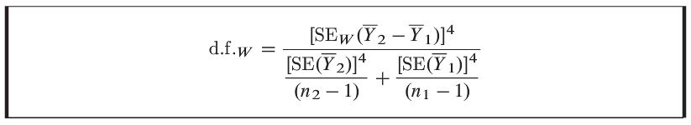
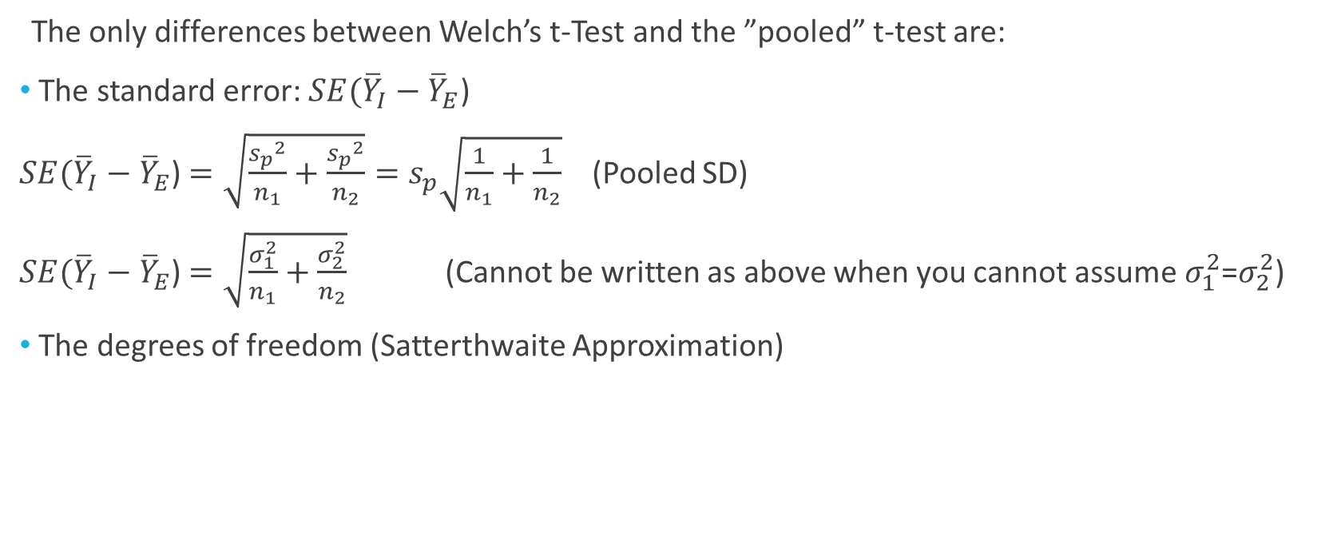
Welch’s t-Test
The only differences between Welch’s t-Test and the ”pooled” t-test are:
The standard error: $SE({\overline{Y}}_{I}−{\overline{Y}}_{E}$)
$SE({\overline{Y}}_{I}−{\overline{Y}}_{E}$) $=\sqrt{\frac{{s_{p}}^{2}}{n_{1}}+\frac{{s_{p}}^{2}}{n_{2}}}=s_{p}\sqrt{\frac{1}{n_{1}}+\frac{1}{n_{2}}}$ (Pooled SD)
$SE({\overline{Y}}_{I}−{\overline{Y}}_{E}$) $=\sqrt{\frac{σ_{1}^{2}}{n_{1}}+\frac{σ_{2}^{2}}{n_{2}}}$ (Cannot be written as above when you cannot assume $σ_{1}^{2}$=$σ_{2}^{2}$)
The degrees of freedom (Satterthwaite Approximation)

Slide 30
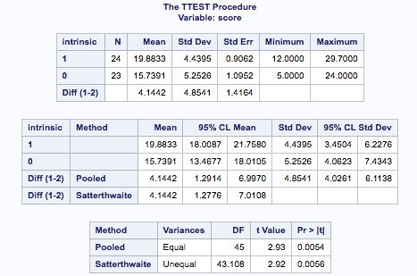

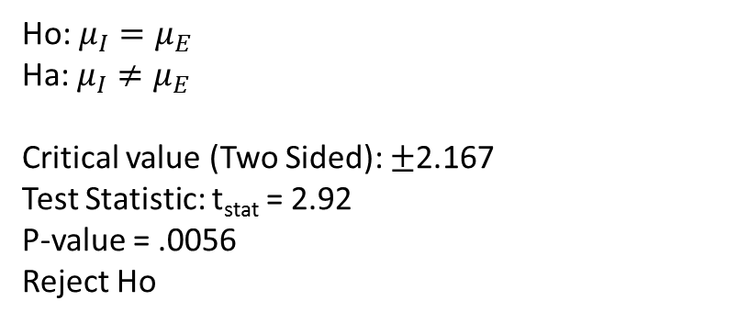
Testing Hypothesis: Welch’s t-Tools
Ho: $μ_{I}=μ_{E}$
Ha: $μ_{I}≠μ_{E}$
Critical value (Two Sided): $±$2.167
Test Statistic: t_{stat} = 2.92
P-value = .0056
Reject Ho
This experiment provides strong evidence that the intrinsic rather than extrinsic motivation is associated with a higher scoring poem (p-value = 0.0056 from a two-sample t-test). The estimated treatment effect is 4.14 pts. (95% confidence interval $\left[1.28, 7.01\right]$ pts on a 40 pt. scale.)

Slide 31
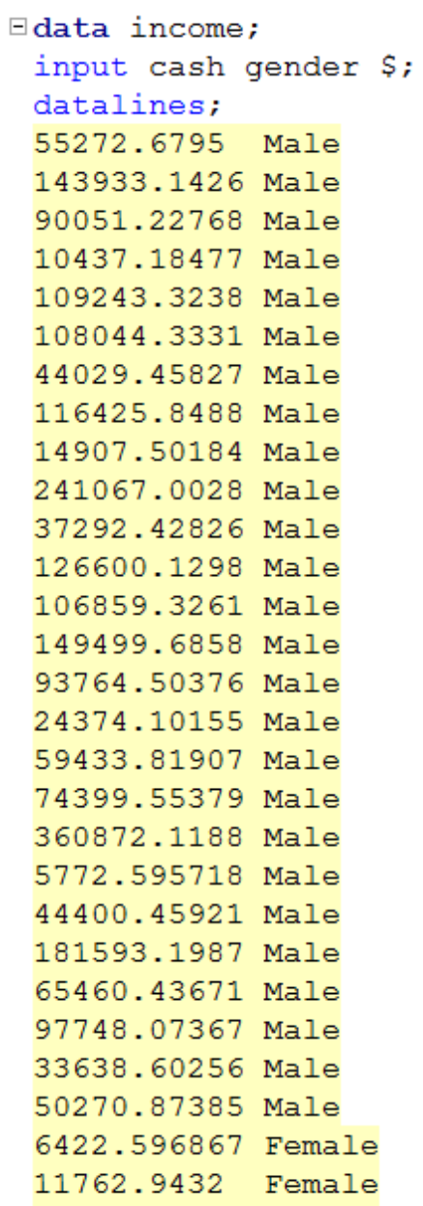
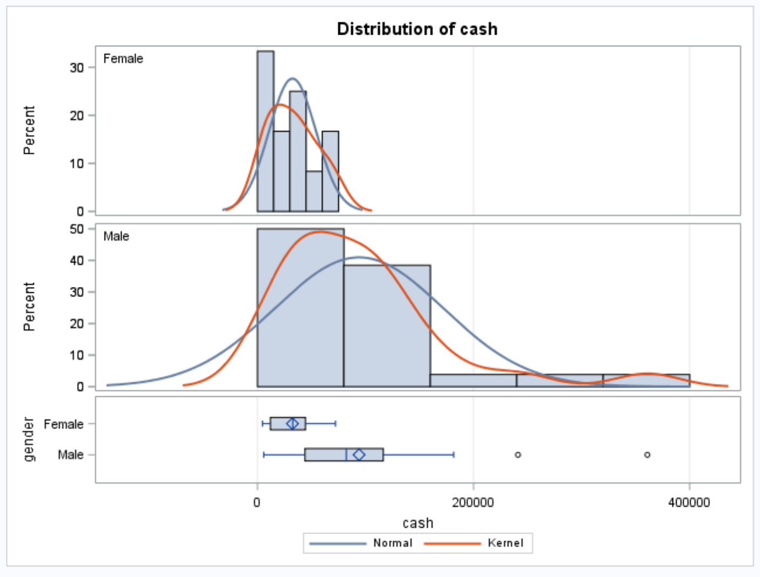
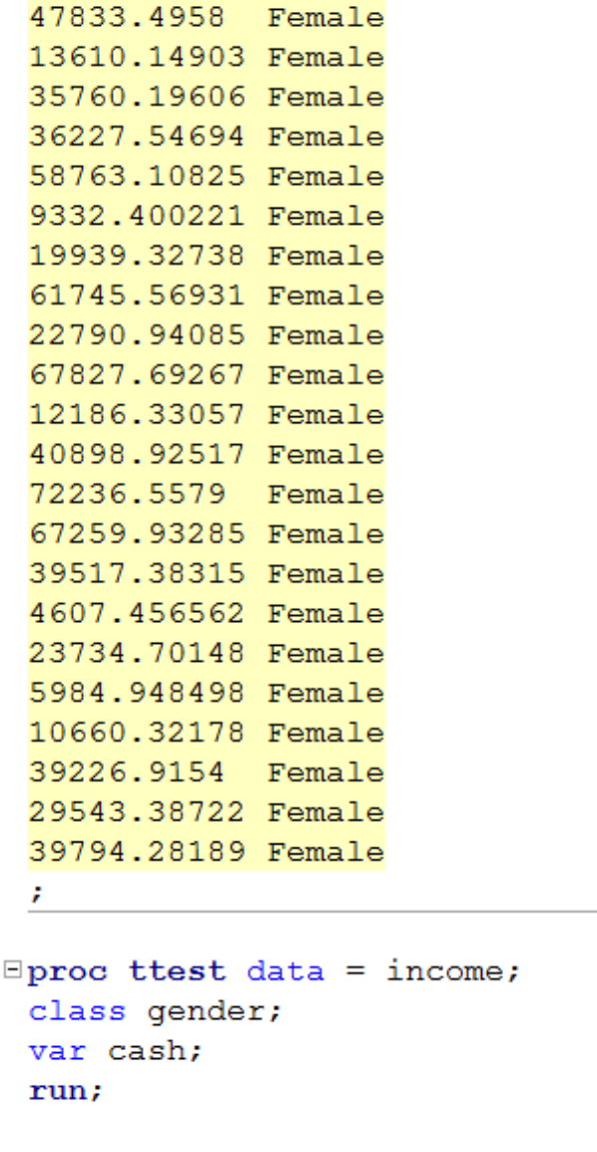
Gender Income Discrimination

Slide 32
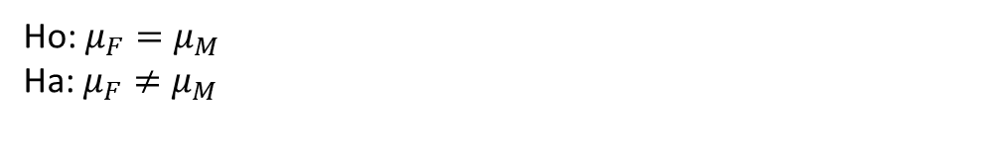
Gender Income Discrimination
Ho: $μ_{F}=μ_{M}$
Ha: $μ_{F}≠μ_{M}$
Strong evidence against normality, but CTL applies.
Strong evidence against equal standard deviations and different sample sizes. (They are close but the standard deviations appear to be so different that this may make a real difference.)
We will assume independence.
Student’s t-test not a good idea here.

Slide 33
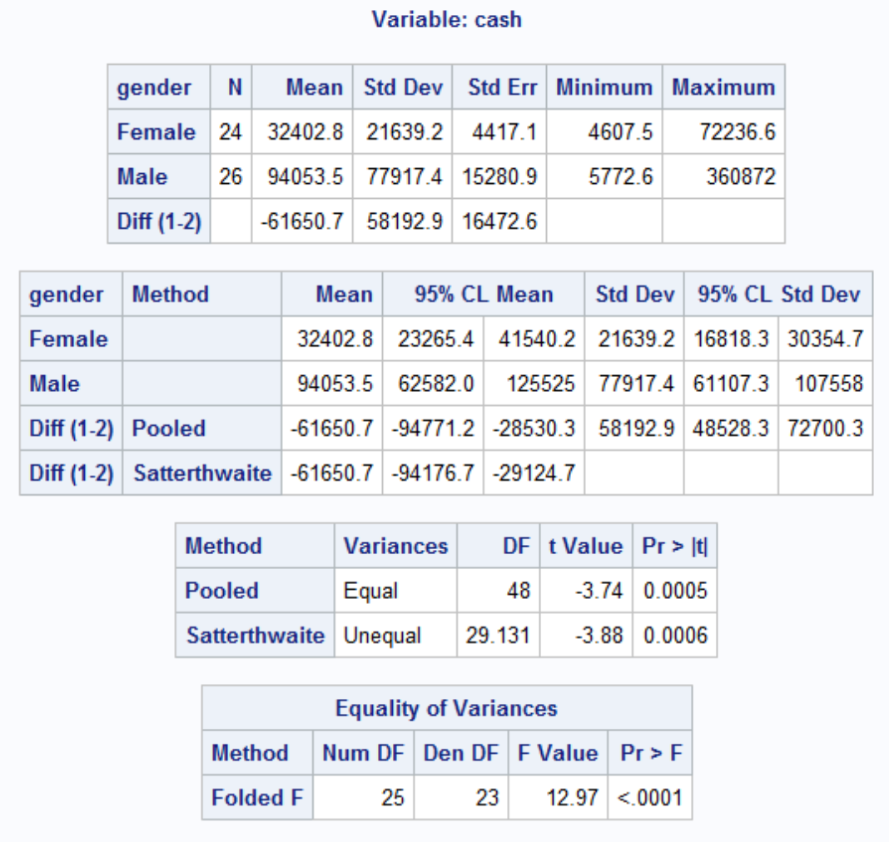
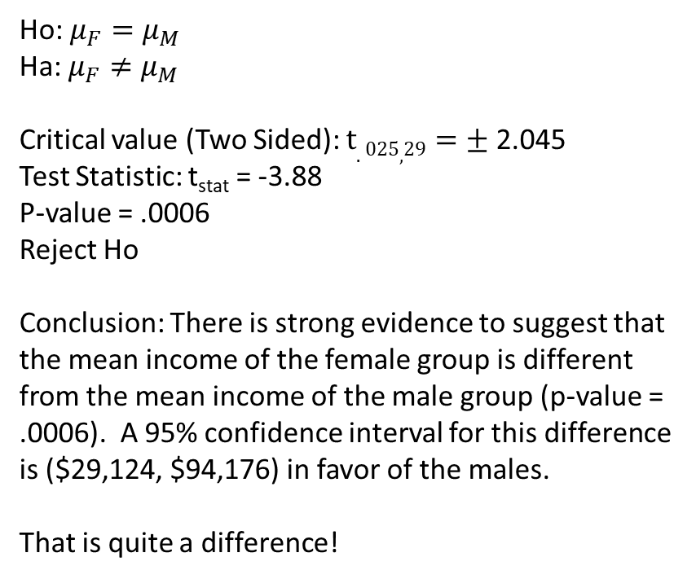
Gender Income Discrimination!
Ho: $μ_{F}=μ_{M}$
Ha: $μ_{F}≠μ_{M}$
Critical value (Two Sided): $t.025,29=±$2.045
Test Statistic: t_{stat} = -3.88
P-value = .0006
Reject Ho
Conclusion: There is strong evidence to suggest that the mean income of the female group is different from the mean income of the male group (p-value = .0006). A 95% confidence interval for this difference is ($29,124, $94,176) in favor of the males.
That is quite a difference!

Slide 34
Rank Sum versus Welch’s … the Take Away
If you wish to make inference on the mean and you have the sample size to invoke the CLT, Welch’s t-test is preferred by most statisticians, and it is robust to different standard deviations even when the sample size is not equal.
Often, especially in skewed distributions, the median is a better measure of center. For this reason, one may prefer the rank sum test even when Welch’s t-test is available.
If you have small sample sizes, you may not be very confident about the normality assumption even if the histograms and q-q plots look okay. For this reason, one may wish to be “conservative” and run the rank sum test and obtain inference on the median.
If there are outliers or censored values, the rank sum test is often the most appropriate as the t-test is not resistant to outliers and has no way of using censored data.

Slide 35
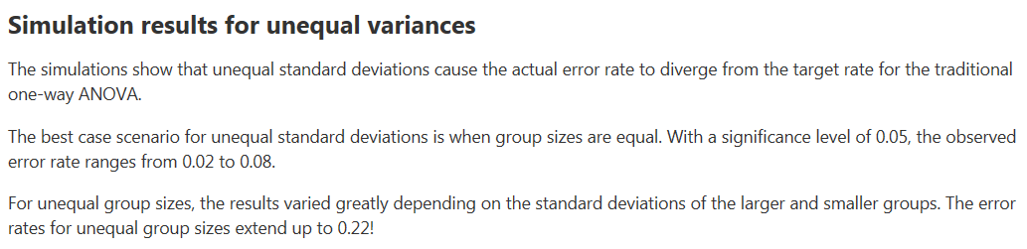
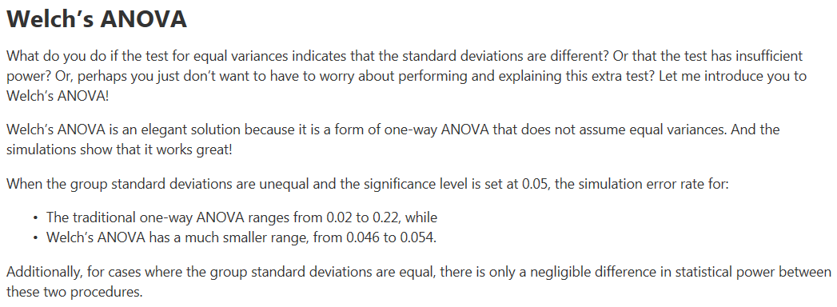
Performance of Welch’s t-test

Slide 36
Paired T-Test

Slide 37
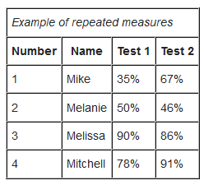
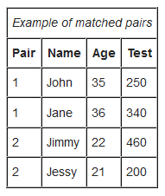
Paired T-Test
Known alternatively as Matched Pairs or Dependent t-Test
Assumptions
Data are either:
From one sample that has been tested twice (example pre- and post-test or repeated measures)
From a group of subjects that are thought to be similar and can thus be matched or paired (example from same family, or twins)
Data are normally distributed, independent between observations, and have identical variances.

Slide 38
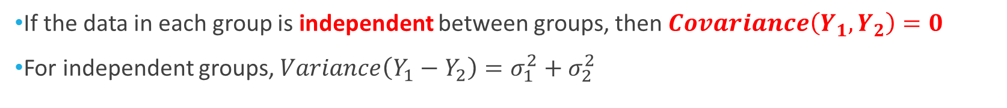
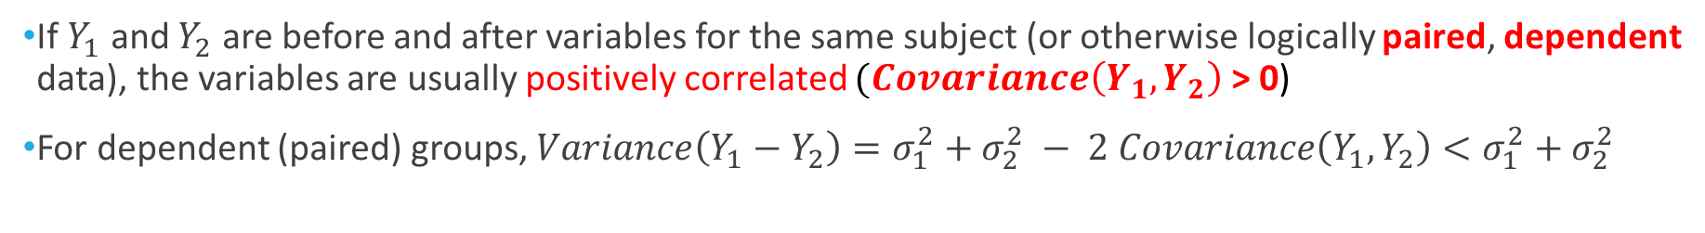
A Look at the Variance
Suppose $Y_{1}$ and $Y_{2}$ are variables for two groups
Fact: $Variance\left(Y_{1}−Y_{2}\right)=σ_{1}^{2}+σ_{2}^{2} − 2 Covariance\left(Y_{1},Y_{2}\right)$
If the data in each group is independent between groups, then $Covariance\left(Y_{1},Y_{2}\right)=0$
For independent groups, $Variance\left(Y_{1}−Y_{2}\right)=σ_{1}^{2}+σ_{2}^{2}$
If $Y_{1}$ and $Y_{2}$ are before and after variables for the same subject (or otherwise logically paired, dependent data), the variables are usually positively correlated $(Covariance\left(Y_{1},Y_{2}\right)$ > 0)
For dependent (paired) groups, $Variance\left(Y_{1}−Y_{2}\right)=σ_{1}^{2}+σ_{2}^{2} − 2 Covariance\left(Y_{1},Y_{2}\right)<σ_{1}^{2}+σ_{2}^{2}$
If data can be paired, the variance can be reduced.

Slide 39
Example: Medical Reasoning Test
The AMA has a diagnostic test for medical reasoning
On average, people score about 500 points on this test
We have data from 10 subjects who took the medical reasoning test. These subjects were randomly selected from St. Paul Hospital in Dallas
Not fatigued: is the baseline, taking the test before a shift
Fatigued: is after the treatment; working for 12 operational hours prior to re-taking the test.
Subject # | Not Fatigued | Fatigued
1 | 567 | 530
2 | 512 | 492
3 | 509 | 510
4 | 593 | 580
5 | 588 | 600
6 | 491 | 483
7 | 520 | 512
8 | 588 | 575
9 | 529 | 530
10 | 508 | 490
(Lower numbers = worse score)

Slide 40

Example: Keith’s Medical Reasoning Test
We can try to test whether the difference of the means between the fatigued scores and the not fatigued scores is less than zero.
$$H_{A}:μ_{fatigued}{−μ}_{not fatigued} <0$$

Slide 41

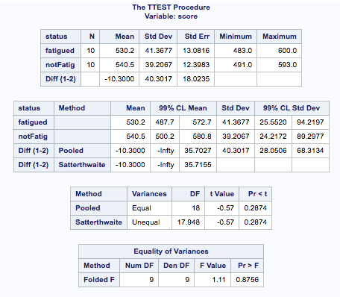
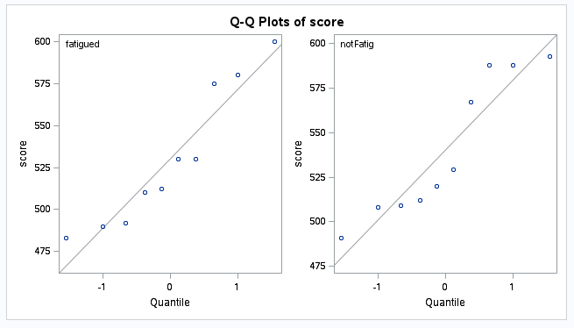
Example: Medical Reasoning Test
If we did this, we would be wrong! Why?
A fundamental assumption is violated: independence

Slide 42


Assumption Check Failure
We need to account for the dependence between the two groups

Slide 43

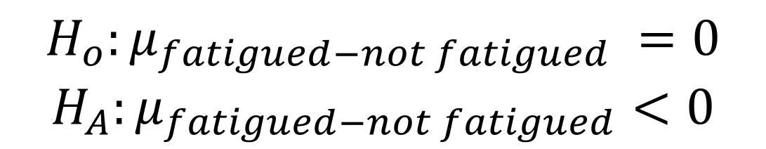
Example: Keith’s Medical Reasoning Test
Instead of testing the difference of the means:
$$H_{A}:μ_{fatigued}{−μ}_{not fatigued} <0$$
Subject | Fatigued | Not Fatigued | Difference
1 | 530 | 567 | -37
2 | 492 | 512 | -20
3 | 510 | 509 | 1
4 | 580 | 593 | -13
5 | 600 | 588 | 12
6 | 483 | 491 | -8
7 | 512 | 520 | -8
8 | 575 | 588 | -13
9 | 530 | 529 | 1
10 | 490 | 508 | -18
We should test the mean of the differences:
$$H_{o}:μ_{fatigued−not fatigued} =0$$
$$H_{A}:μ_{fatigued−not fatigued}<0$$

Slide 44

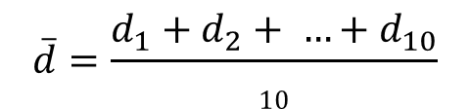
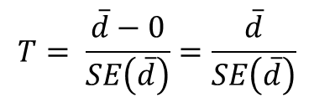
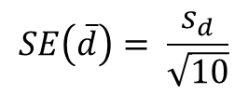
Paired t-test reduces to a one-sample t-test
Ho: d = 0
Ha: d < 0
(d_{i})
Subject | Fatigued | Not Fatigued | Difference
1 | 530 | 567 | -37
2 | 492 | 512 | -20
3 | 510 | 509 | 1
4 | 580 | 593 | -13
5 | 600 | 588 | 12
6 | 483 | 491 | -8
7 | 512 | 520 | -8
8 | 575 | 588 | -13
9 | 530 | 529 | 1
10 | 490 | 508 | -18
$$\overline{d}=\frac{d_{1}+d_{2}+ …+d_{10}}{10}$$
$sd$ is the sample std. dev.
$$SE\left(\overline{d}\right)= \frac{s_{d}}{\sqrt{10}}$$
$$T= \frac{\overline{d}−0}{SE\left(\overline{d}\right)}=\frac{\overline{d}}{SE\left(\overline{d}\right)}$$

Slide 45
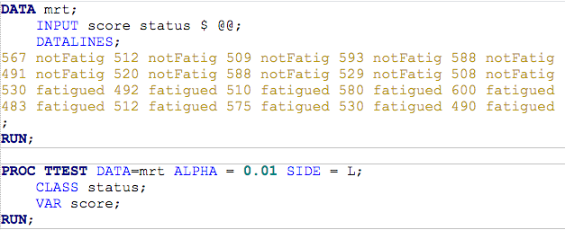
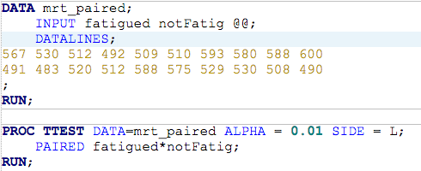
A SAS Code Comparison
Two (independent) sample T-Test
Paired T-test

Slide 46

A SAS Code Comparison
Using paired data (when appropriate) instead of unpaired data allows us to tighten the confidence interval for the difference in means (yeah!) AND increase the power (the likelihood that our data properly detects a shift in score).
Paired T-test
Two (independent) sample T-Test

Slide 47


Checking the Assumptions
There is little to no evidence that the differences do not come from normal distribution.
We will assume that the differences are independent. Is this a reasonable assumption?

Slide 48

Additional Information
We can look at a profile plot
The lines connect the scores on the MRT in the “fatigued” versus “not fatigued” states

Slide 49

Conclusion (alpha = .01)
Fail to Reject Ho
Statistical Conclusion: There is not enough evidence to suggest that, on average, the fatigued subjects score lower than the non-fatigued subjects (p-value = .0196). A 99% one sided confidence interval for the mean difference in scores is (-infinity, 1.76).
Scope of Inference: Since this was a random sample from St. Paul Hospital in Dallas, we can infer that this result would be repeated for any group selected from this hospital. There is no way to guarantee a causal inference from a paired t-test.
Note: The elusiveness of the causal inference comes from the fact that the treatment that induces fatigue may itself be a confounder. Some may work for 12 hours as a surgeon and others may work 12 hours writing reports. There is reason to believe that if a difference is detected, this difference may not be due to fatigue rather may be due to the type of work.
$$H_{o}:μ_{fatigued−not fatigued} =0$$
$$H_{A}:μ_{fatigued−not fatigued}<0$$
Critical Value: t_{.01,9} = -2.8211.833
Test Statistic: t_{stat}= -2.41
P-value = .0196 > .01

Slide 50
Conclusion (if alpha = .05)
Reject Ho
Statistical Conclusion: There is sufficient evidence to suggest that, on average, the fatigued subjects score lower than the non-fatigued subjects (p-value = .0196). A 95% one sided confidence interval for the mean difference in scores is (-infinity, 1.76).
Scope of Inference: Since this was a random sample from St. Paul Hospital in Dallas, we can infer that this result would be repeated for any group selected from this hospital. Since we are dealing with an average effect and the treatment is not well defined, it is not possible to draw causal inference from these paired data. We can only conclude that fatigue is associated with lower scores. For example, if one of these subjects was a surgeon and the rest were researchers, it is possible that only the surgeon would show a significant reduction (let’s say it was large) but his/her large difference may pull the mean down sufficiently to reject for the whole test. The cause may be the intense pressure of surgery that is confounding the intended treatment of “fatigue.”
$$H_{o}:μ_{fatigued−not fatigued} =0$$
$$H_{A}:μ_{fatigued−not fatigued}<0$$
Critical Value: t_{.01,9} = -2.8211.833
Test Statistic: t_{stat}= -1.833
P-value = .0196 < .05

Slide 51
Appendix

Slide 52
Alternatives to the t-Test for Paired Data

Slide 53

For each of the 9 horses, a veterinary anatomist measured the density of nerve cells at specified sites in the intestine.
Example: Nerve Data
horse | site1 | site2
6 | 14.2 | 16.4
4 | 17 | 19
8 | 37.4 | 37.6
5 | 11.2 | 6.6
7 | 24.2 | 14.4
9 | 35.2 | 24.4
3 | 35.2 | 23.2
1 | 50.6 | 38
2 | 39.2 | 18.6

Slide 54



Using the paired t-Test
The sample size is rather small, hence the normality assumption is suspect.

Slide 55

The Hypothesis Test
The hypotheses will be in terms of medians instead of means
$H_{0}$: The median difference in nerve cell count between “site 1” and “site 2” is zero
The Alternative Hypotheses:
$H_{A}$: The median difference in nerve cell count between “site 1” and “site 2” is not zero
$H_{A}$: The median difference in nerve cell count between “site 1” and “site 2” is greater than zero
(Two sided)
(one sided)

Slide 56



Sign Test: Horse Data
$H_{A}$: The median difference in nerve cell count between “site 1” and “site 2” is > 0
$$z= \frac{K−.5 −n/2}{\sqrt{n/4}}$$
horse | site1 | site2 | diff | Sign
8 | 37.4 | 37.6 | -0.2 | -
4 | 17 | 19 | -2 | -
6 | 14.2 | 16.4 | -2.2 | -
5 | 11.2 | 6.6 | 4.6 | +
7 | 24.2 | 14.4 | 9.8 | +
9 | 35.2 | 24.4 | 10.8 | +
3 | 35.2 | 23.2 | 12 | +
1 | 50.6 | 38 | 12.6 | +
2 | 39.2 | 18.6 | 20.6 | +
$$= \frac{6− .5 −9/2}{\sqrt{9/4}}=.6666$$
K = 6
$$P\left(Z>.6666\right)=0.2527$$
(one sided, CC p-value)

Slide 57
Test and Conclusion
$H_{0}$: The median difference in nerve cell count between “site 1” and “site 2” is zero
$H_{A}$: The median difference in nerve cell count between “site 1” and “site 2” is positive.
Critical Value (right sided): z_{.05}=1.645
P-value (one sided) = .2527
t statistic: t_{stat} = 0.666
Fail to Reject Ho.
Statistical Conclusion: There is not enough evidence that the median nerve density at site 1 is greater than the median nerve density at site 2 (Wilcoxon sign test one-sided p-value of 0.2527).

Slide 58



Signed Rank Test: Horse Data
horse | site1 | site2 | abs(diff) | Sign | rank
8 | 37.4 | 37.6 | 0.2 | - | 1
4 | 17 | 19 | 2 | - | 2
6 | 14.2 | 16.4 | 2.2 | - | 3
5 | 11.2 | 6.6 | 4.6 | + | 4
7 | 24.2 | 14.4 | 9.8 | + | 5
9 | 35.2 | 24.4 | 10.8 | + | 6
3 | 35.2 | 23.2 | 12 | + | 7
1 | 50.6 | 38 | 12.6 | + | 8
2 | 39.2 | 18.6 | 20.6 | + | 9
$$z= \frac{S −Mean(S)}{SD(S)}$$
$$= \frac{39 − .5 −(9∗10)/4}{\sqrt{9∗10∗19/24}}=\text{1.}\text{89}$$
$$P\left(Z>1.89\right)=0.02938$$
S = 39
(one sided, CC p-value)

Slide 59
Test, Conclusion and Some Notes
$H_{0}$: The median difference in nerve cell count between “site 1” and “site 2” is zero
$H_{A}$: The median difference in nerve cell count between “site 1” and “site 2” is positive.
Critical Value (right sided): z_{.05}=1.645
P-value (one sided) = .0294
t statistic: t_{stat} = 1.89
Reject Ho.
Statistical Conclusion: There is strong evidence that the median nerve density at site 1 is greater than the median nerve density at site 2 (Wilcoxon signed rank test one-sided p-value of 0.0294).
Note:
The signed-rank test has more power than the sign test
(Compare the p-values 0.254 vs. 0.0294)
Both tests make very few assumptions about the distributions

Slide 60

Horse Data
Note: These are two sided…. Half of this is close to our calculated one sided p-values from earlier.
Note: For n < 20 SAS uses the probabilities from the binomial distribution rather than the normal approximation. These are more accurate (exact) and we should use these when SAS is available.

